Slide 1
Welcome to my Presentation

Slide 2
Presentation on Digital Logic Design
Presented By:
Name : Tushar Sarkar
Student ID: 18CSE035
Second Year First Semester
Department of CSE,BSMRSTU,
Gopalganj-8100.

Slide 3

Outline
Question
$F_{1 }{And F}_{2}$ Determine
$F_{1}^{′}$ And $F_{2}^{′}$ Determine
PLA Program Table
Logic Diagram

Slide 4
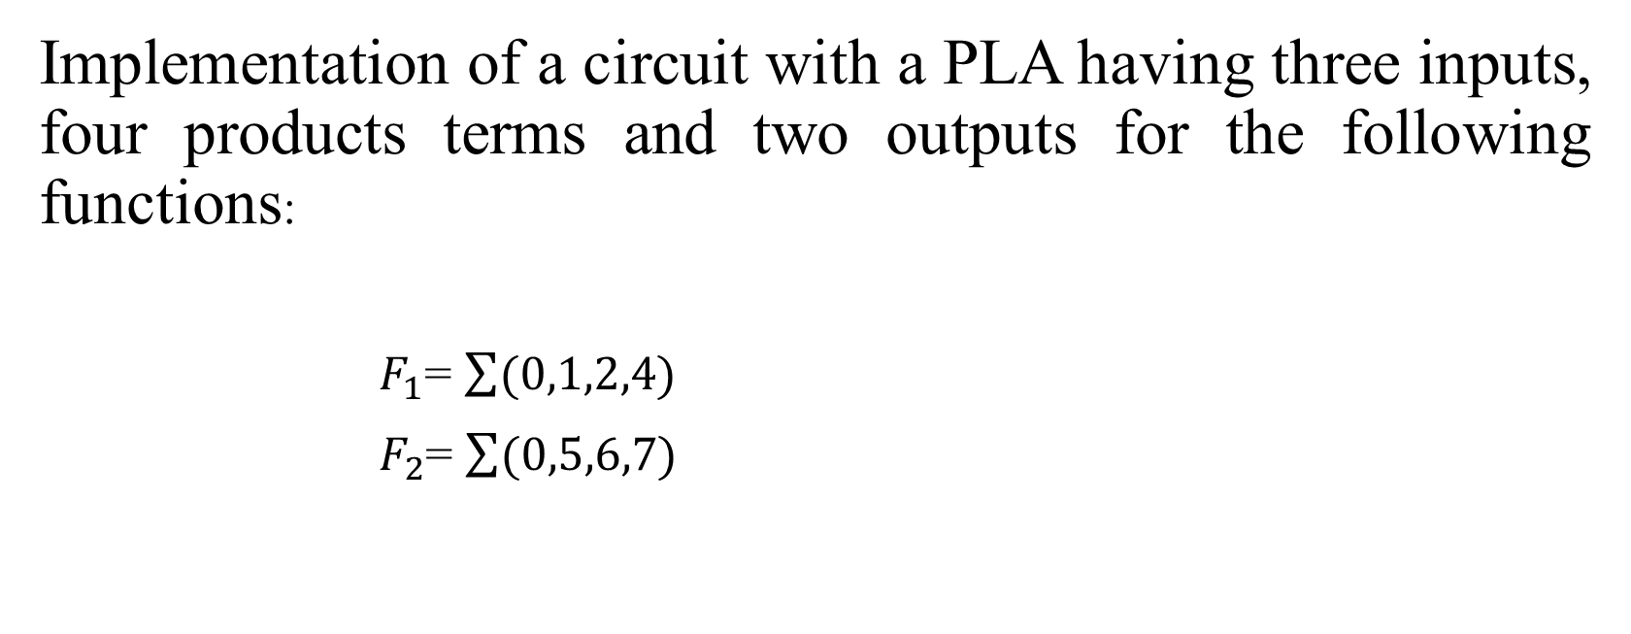
My Question is 5
Implementation of a circuit with a PLA having three inputs, four products terms and two outputs for the following functions:
$F_{1}$= $\sum{(0,1,2,4)}$
$F_{2}$= $\sum{(0,5,6,7)}$

Slide 5



$F_{1}$ and $F_{2}$ Determination
$F_{2}$= $A^{′}B^{′}C^{′}$ + AC + BC
$$A^{′}C^{′}$$
$$A^{′}B^{′}$$
$F_{1}$=$A^{′}B^{′}$ + $A^{′}C^{′}$ + $B^{′}C^{′}$
BC A | 00 | 01 | 11 | 10
0 | 1 | 1 |  | 1
1 | 1
BC A | 00 | 01 | 11 | 10
0 | 1
1 |  | 1 | 1 | 1

Slide 6



$F_{1}^{′}$ and $F_{2}^{′}$ Determination
$F_{2}^{′}$ = (A$B^{′}C^{′}$ + $A^{′}$C + $A^{′}$B)
$F_{2}$ = ${\text{(}\text{A}B^{′}C^{′}\text{ + }A^{′}\text{C}\text{ + }A^{′}\text{B}\text{) }}^{′}$
$$A^{′}C^{′}$$
$$A^{′}B^{′}$$
$F_{1}^{′}$ = (AB + AC + BC)
$F_{1}$ =${ (AB+AC+BC)}^{′}$
BC A | 00 | 01 | 11 | 10
0 |  |  | 0
1 |  | 0 | 0 | 0
BC A | 00 | 01 | 11 | 10
0 |  | 0 | 0 | 0
1 | 0

Slide 7
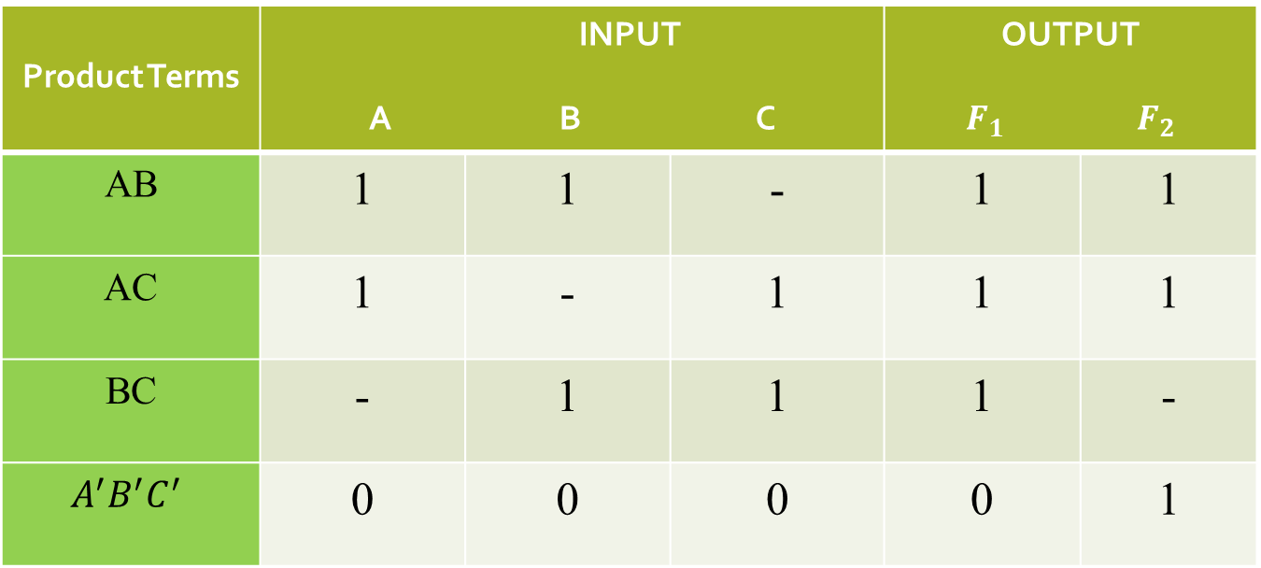
PLA Program Table
Product Terms | INPUT A B C |  |  | OUTPUT $F_{1}$ $F_{2}$
AB | 1 | 1 | - | 1 | 1
AC | 1 | - | 1 | 1 | 1
BC | - | 1 | 1 | 1 | -
$$A^{′}B^{′}C^{′}$$ | 0 | 0 | 0 | 0 | 1
C | T | T/C

Slide 8






Logic Diagram

Slide 9
Thank You

